Slide 1

Artificial Neural Networks & Deep Learning
PBL AI253AI
Deep Learning Based Oil Spill Attribution
Using CNN and LSTM
Neetu Aekabote | 1RV24CI075
Rachit Mittal | 1RV24CI089
30th September, 2026

Slide 2

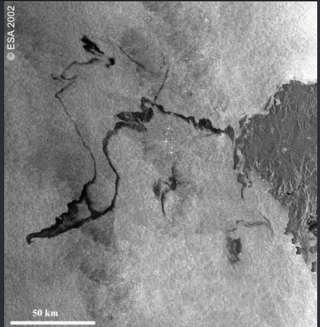
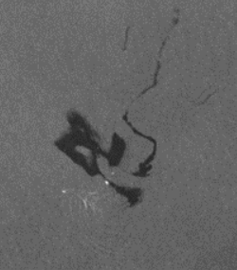
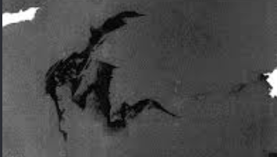
Problem Definition
Manual SAR slick analysis is slow and error-prone
SAR cannot tell oil from look-alikes (algae films, low wind, rain)
Slicks are seen hours after release
Source and release time are unknown
Problem Statement
Maritime pollution response authorities, struggle to identify whether the dark SAR images are oil slicks along with approximate the time and cause vessel of it leading to environmental contamination and possible unattended disasters
30th September, 2026

Slide 3
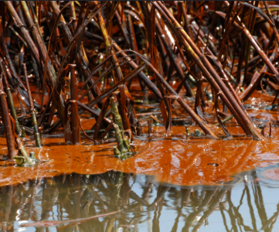
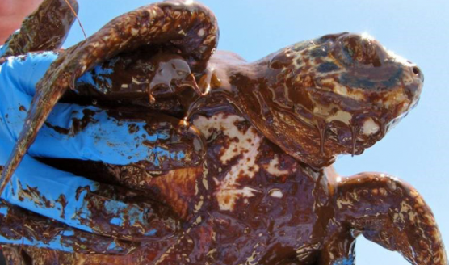
Real World Significance
Previous works
Krestenitis 2019: early DNNs for SAR oil identification
Bianchi 2020 (OFCN): U-Net family on full Sentinel-1 scenes
Shaban 2021: CNN + U-Net, Dice 0.80
Chen & Wang 2022: Attention U-Net with polarimetric + wind inputs
OSDA-SAM 2026: adapted Segment Anything, F1 0.86
Capobianco 2021: LSTM vessel-track prediction
Ship discharges harm marine life, fisheries and coasts
EMSA CleanSeaNet: SAR + AIS + drift, alerts sent to national authorities
SAR-AIS-drift tracing: Longépé 2015, Busler 2015, Liu 2021, Luo 2024
30th September, 2026

Slide 4
Literature Survey
Area | Existing work | Limitation | Our improvement
Classical threshold | Topouzelis 2008; ESA tutorial | Threshold-sensitive; look-alike false alarms | Kept as baseline (M0)
DL segmentation | Bianchi 2020; Shaban 2021; Chen & Wang 2022 | Random tile splits leak; scores not comparable | Scene-wise split, same metrics
Datasets | Deep-SAR SOS (21 source scenes) | Noisy masks (~38% of train masks revised in 2025) | Use refined release
DARTIS | Look-alike patches | Bounding boxes only, not pixel masks | Hard-negative stress test
AIS + LSTM | Capobianco 2021; GeoTrackNet | Predict tracks/anomalies, not spills | LSTM for track forecast only
SAR + AIS + drift | Longépé 2015; Busler 2015 | Physics/rules only; no controlled DL comparison | Compare against physics-only ranking
30th September, 2026

Slide 5
Gap Identification and Architecture Choice
Gaps Identified:
Results use different splits, labels and metrics
Neural track uncertainty and drift rarely tested together
Look-alike and missing-AIS robustness rarely reported
Labels seldom verified
Why U-Net?
Pixel-wise masks; skip connections keep boundaries; works with limited labels; many SAR-oil precedents
Why physics-based drift?
Wind and currents move the slick, not the ship, so an LSTM cannot replace the drift model
Why LSTM?
Gated memory handles sequences and gaps; used for AIS forecasting; tested against Kalman and constant-speed baselines
30th September, 2026

Slide 6
References
1.Brekke & Solberg (2005). Oil spill detection by satellite remote sensing. Remote Sensing of Environment 95(1).
2.Jafarzadeh et al. (2021). SAR oil spill detection: meta-analysis. GIScience & Remote Sensing 58(7).
3.Ronneberger, Fischer & Brox (2015). U-Net. MICCAI.
4.Hochreiter & Schmidhuber (1997). Long Short-Term Memory. Neural Computation 9(8).
5.Krestenitis et al. (2019). Oil spill identification using deep neural networks. Remote Sensing 11(15).
6.Bianchi, Espeseth & Borch (2020). Large-scale detection with deep learning. Remote Sensing 12(14).
7.Shaban et al. (2021). Deep-learning framework for oil spill detection. Sensors 21(7).
8.Chen & Wang (2022). Attention U-Net with polarimetric + wind data. IJERPH 19(19).
9.Giannopoulos et al. (2026). Domain-adapted Segment Anything for oil spills. Remote Sensing 18(12).
10.Zhu et al. (2021). CBD-Net and Deep-SAR SOS dataset. IEEE TGRS.
11.Zuenko & Khaidarova (2025). Refined Deep-SAR SOS dataset. Zenodo, doi:10.5281/zenodo.15298010.
12.Yang et al. (2025). DARTIS dataset, Eastern Mediterranean. Earth System Science Data 17.
13.Capobianco et al. (2021). Vessel trajectory prediction with RNNs. IEEE TAES 57(6).
14.Longépé et al. (2015). Polluter identification with SAR, AIS and drift. Marine Pollution Bulletin 101.
15.Busler et al. (2015). Tracking vessels to illegal discharges. ISPRS Archives XL-7/W3.
16.Dagestad et al. (2018). OpenDrift v1.0. Geoscientific Model Development 11.
17.EMSA. CleanSeaNet service; NOAA. GNOME / WebGNOME.
18.NOAA Marine Cadastre and Danish Maritime Authority: AIS data.
30th September, 2026

